Slide 1
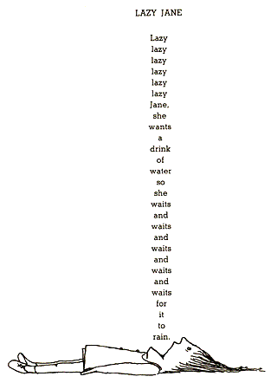

Lazy Evaluation: stop wasting memory and time
Juozas “Joe” Kaziukėnas
http://juokaz.com / juozas@juokaz.com / @juokaz

Slide 2

Who is this guy?
Juozas Kaziukėnas, Lithuanian
You can call me Joe
~4 years in Edinburgh, UK
CEO of Web Species Ltd
Occasional open source developer
Conferences speaker
More info in http://juokaz.com
Tweet me @juokaz

Slide 3
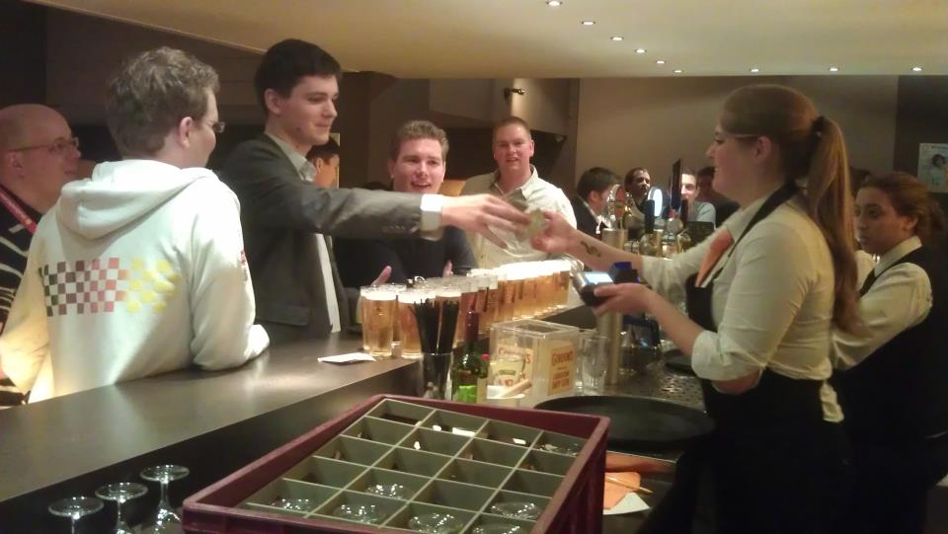
I make fun happen

Slide 4

I organize a conference

Slide 5

Lazy
Notes:
Processing data one item at a time

Slide 6

Notes:
Trying to get everything
Buffers
Memory limits

Slide 7
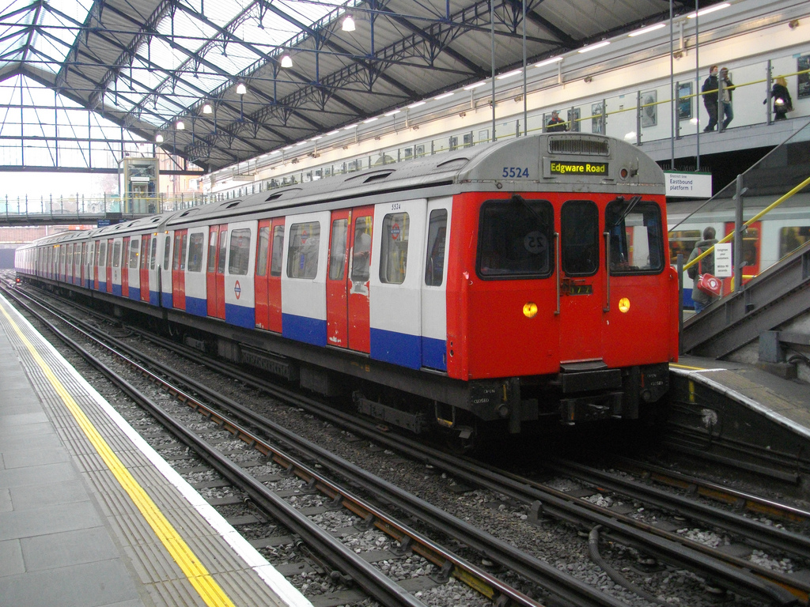
Data chains
Notes:
Train arrives
Wait to process
Takes up space

Slide 8

Notes:
Apply a function to all elements
Apply multiple functions to all elements

Slide 9
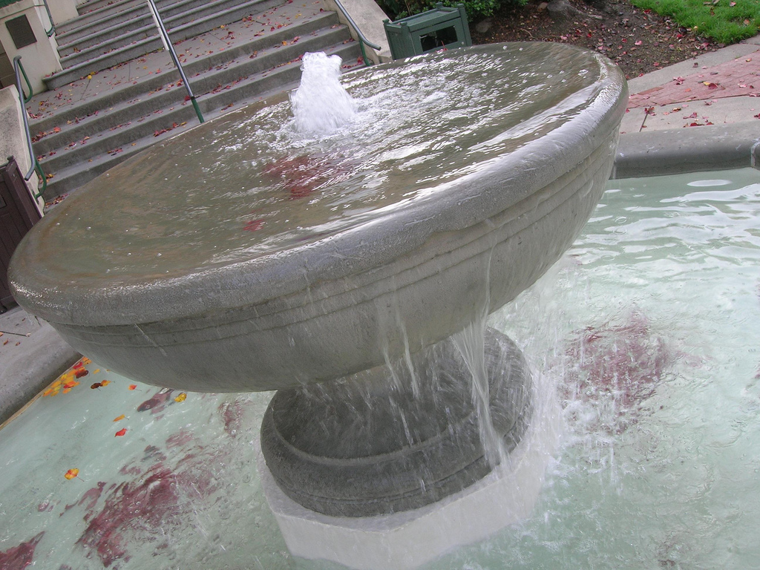
Flow of data
Notes:
A data stream arrives, you store it, do some actions, store the result, etc.
N data elements, 2N of data after first iteration

Slide 10
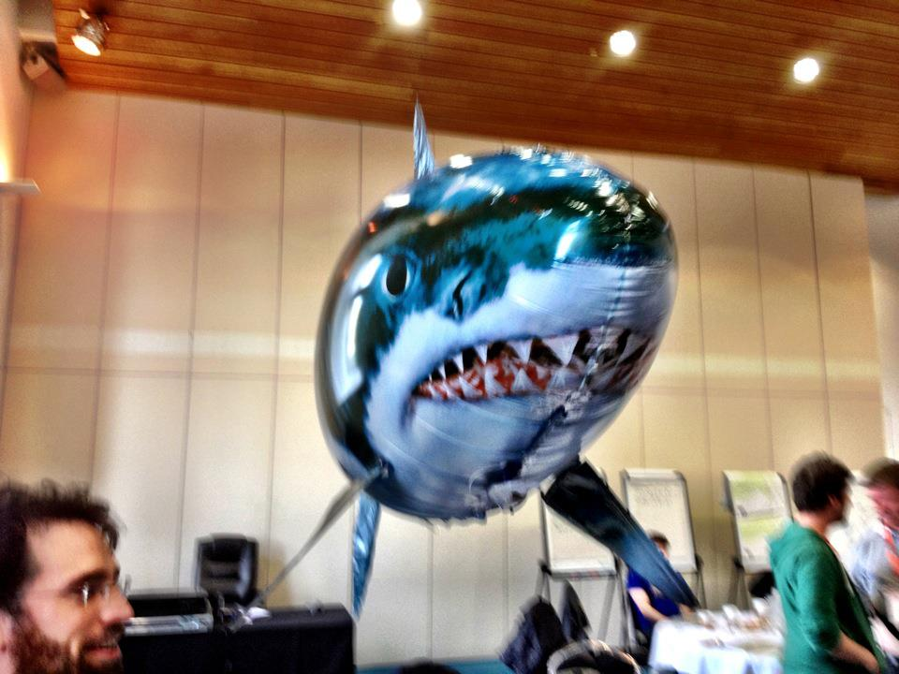
Sharks

Slide 11

Notes:
Memory management

Slide 12

Infinite data
Notes:
Creating abstract structures

Slide 13
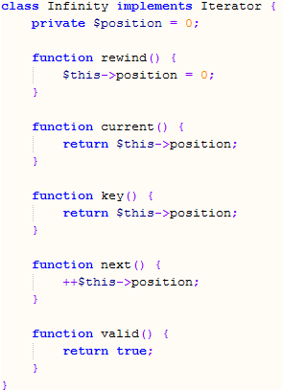

Slide 14
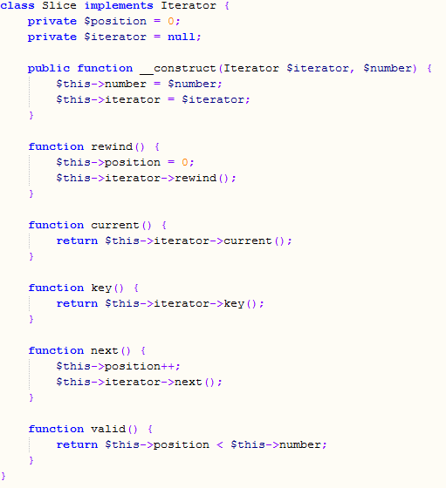

Slide 15
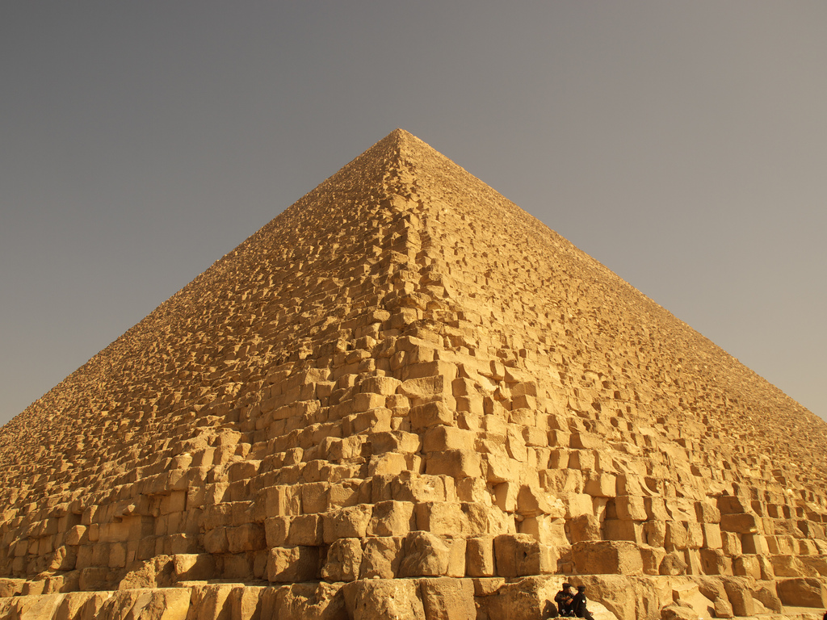
Size matters
Notes:
We can’t fit all data
We don’t need all data

Slide 16

Notes:
XML is great
Process files without reading all data
Parse files without reading all data

Slide 17
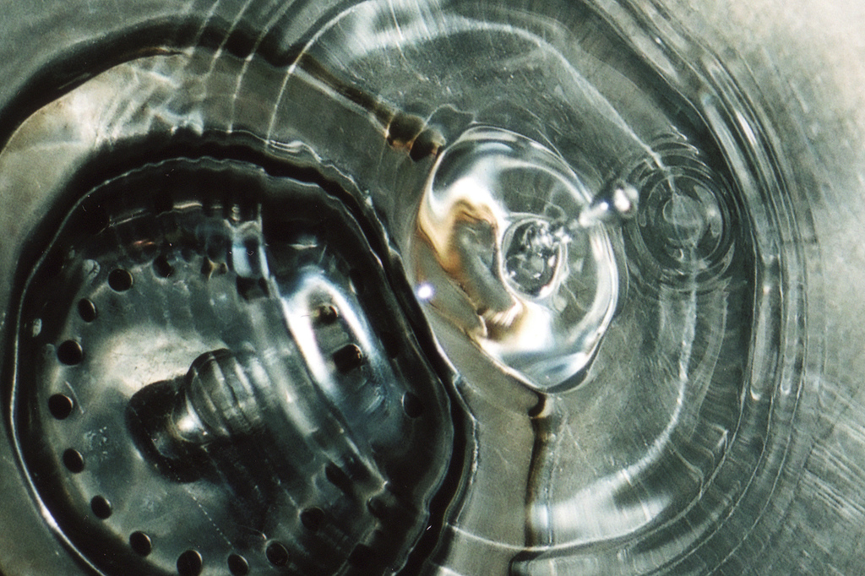
Data sinks
Notes:
As soon as you have something, or a buffer of size Z, process it

Slide 18

mysql_unbuffered_query

Slide 19
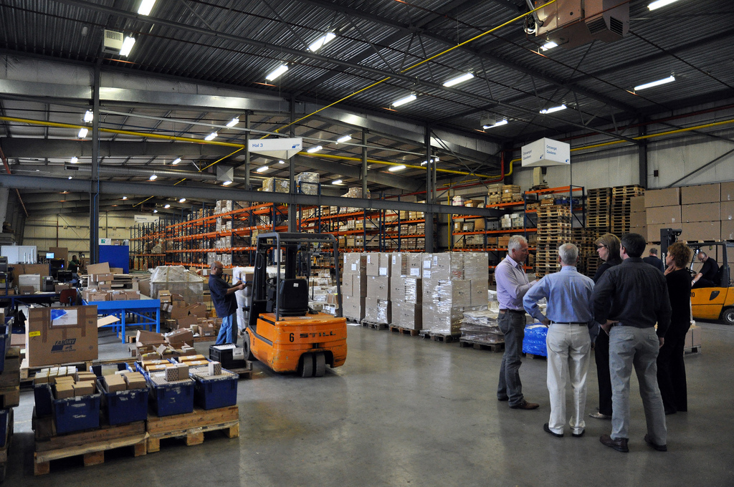
Case story

Slide 20
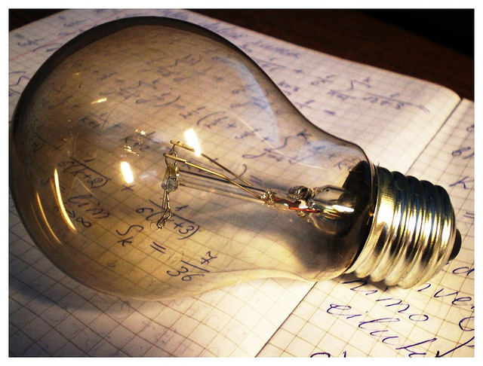
Ideas

Slide 21

Closures
Map Reduce

Slide 22


Slide 23
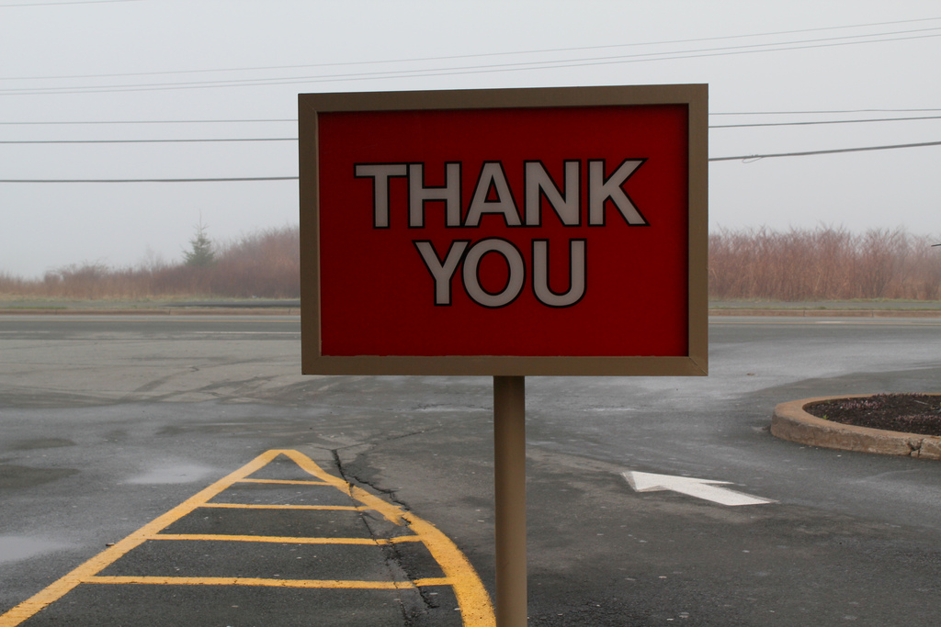
Keep in touch
http://juokaz.com
juozas@juokaz.com
twitter: @juokaz

